Slide 1
Weekly report: Tower structure
Week number: 02
Date: 06/10/2025
Supervisor: Prof. Faber
Group members: Ibrahim Mostafa, Mohammed Eldemerdash, Kirolls Ghaly
Speaker: Ibrahim Mostafa(770134)

Slide 2
List of contents
Selecting Suitable Dimensions for the Tower
Group members: Ibrahim Mostafa, Mohammed Eldemerdash, Kirolls Ghaly
Tower structure team/ Optimus Syria

Slide 3
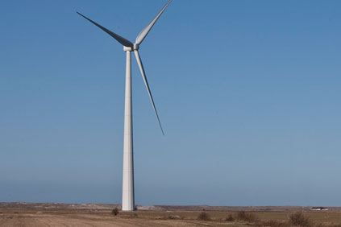
1-Tubular Steel tower system primary design
Tubular steel tower for Siemens
Group members: Ibrahim Mostafa, Mohammed Eldemerdash, Kirolls Ghaly
Tower structure team/ Optimus Syria

Slide 4
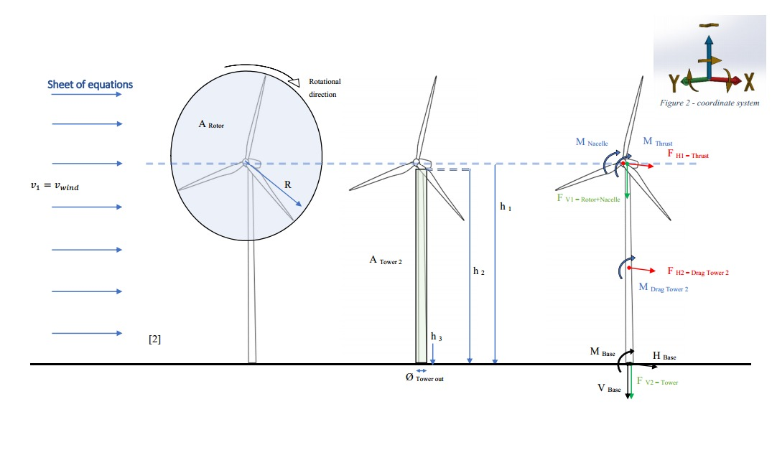
Loads calculations and stress analysis
Fig 9: how the different loads and moments affect the wind turbine
Group members: Ibrahim Mostafa, Mohammed Eldemerdash, Kirolls Ghaly
Tower structure team/ Optimus Syria

Slide 5
Loads calculations and stress analysis
Assumptions
𝜌_{air}=1.225 kg/m³
𝜌_{steel}=7850 kg/m³
(Wind class III) 𝑉=37.5 m/s
𝑔=10 m/s²
𝐷_{rotor}=160 m, 𝐷_{𝑜}=6.0 m, 𝑡=0.027 m
⇒ 𝐷_{𝑖}=5.946
𝐻_{tower}=98 m
ℎ_{hub}=100 m
𝐶_{𝑇}=0.5
𝐶_{𝐷}=1 ​
𝑚_{rotor}=110,000 kg
𝑚_{nacelle}=240,000 kg
𝑚_{RNA}=350,000 kg
𝑀_{nacelle}=4200 kN
Reference to data assumptions:
https://www.nrel.gov/wind/data-tools
Group members: Ibrahim Mostafa, Mohammed Eldemerdash, Kirolls Ghaly
Tower structure team/ Optimus Syria

Slide 6
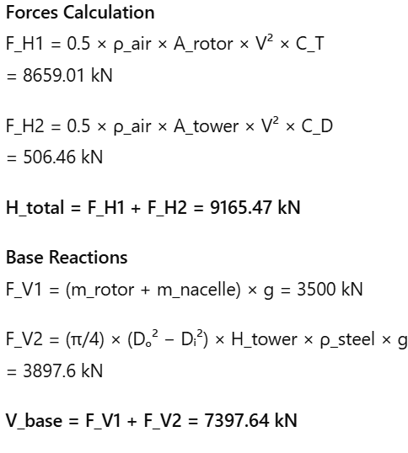
Loads calculations and stress analysis
Group members: Ibrahim Mostafa, Mohammed Eldemerdash, Kirolls Ghaly
Tower structure team/ Optimus Syria

Slide 7
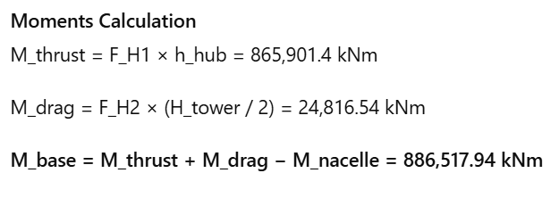
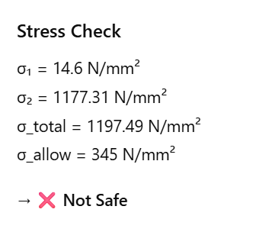
Loads calculations and stress analysis
Group members: Ibrahim Mostafa, Mohammed Eldemerdash, Kirolls Ghaly
Tower structure team/ Optimus Syria

Slide 8
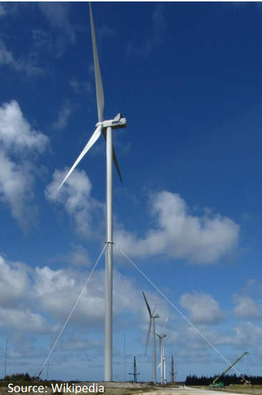
2. Tubular steel tower with tie system, primary design.
Assumptions
𝜌_{air}=1.225 kg/m³
𝜌_{steel}=7850 kg/m³
(Wind class III) 𝑉=37.5 m/s
𝑔=10 m/s²
𝐷_{rotor}=160 m, 𝐷_{𝑜}=9.0 m, 𝑡=0.027 m
⇒ 𝐷_{𝑖}=8.946
𝐻_{tower}=98 m
ℎ_{hub}=100 m
Group members: Ibrahim Mostafa, Mohammed Eldemerdash, Kirolls Ghaly
Tower structure team/ Optimus Syria

Slide 9
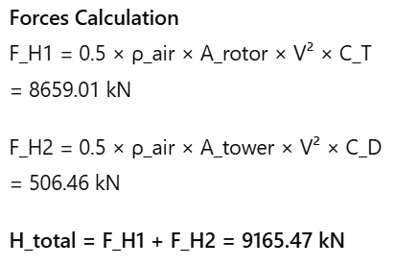
2. Tubular steel tower with tie system, primary design.
Group members: Ibrahim Mostafa, Mohammed Eldemerdash, Kirolls Ghaly
Tower structure team/ Optimus Syria

Slide 10
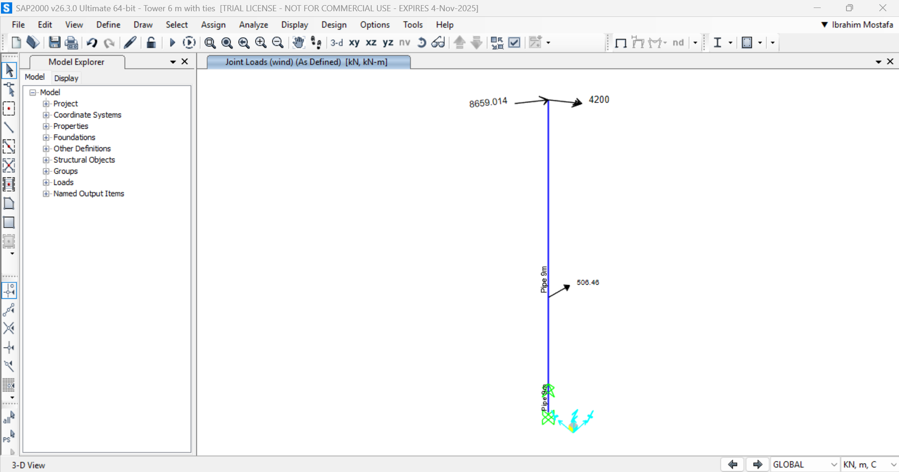
2. Tubular steel tower with tie system, primary design.
Group members: Ibrahim Mostafa, Mohammed Eldemerdash, Kirolls Ghaly
Tower structure team/ Optimus Syria

Slide 11
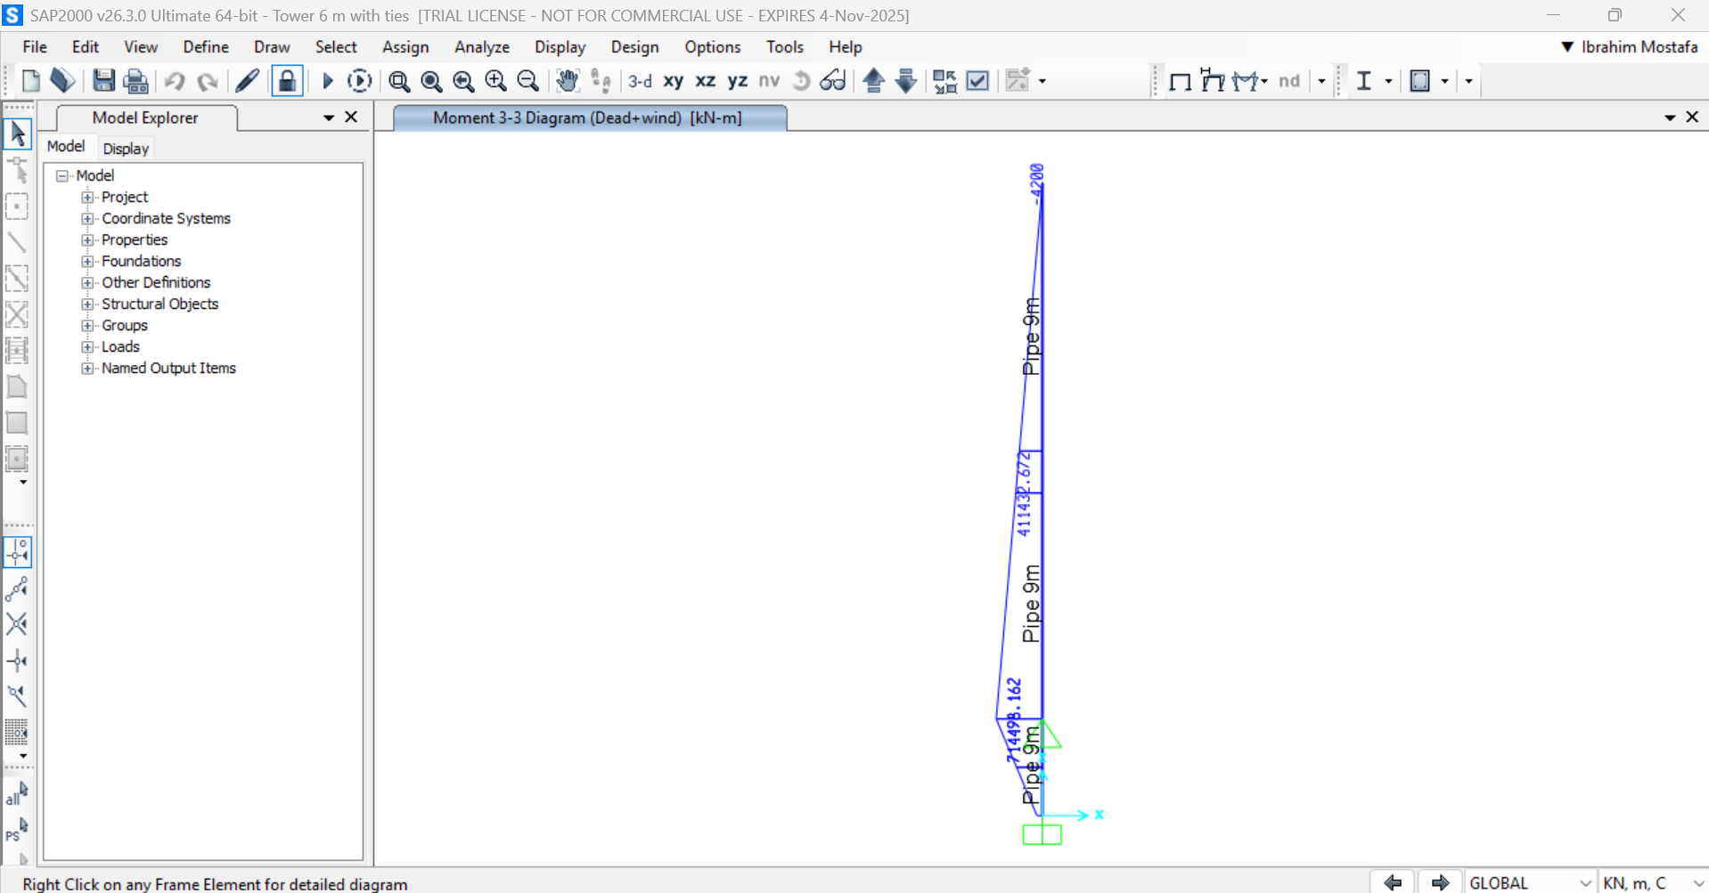
2. Tubular steel tower with tie system, primary design.
Group members: Ibrahim Mostafa, Mohammed Eldemerdash, Kirolls Ghaly
Tower structure team/ Optimus Syria

Slide 12
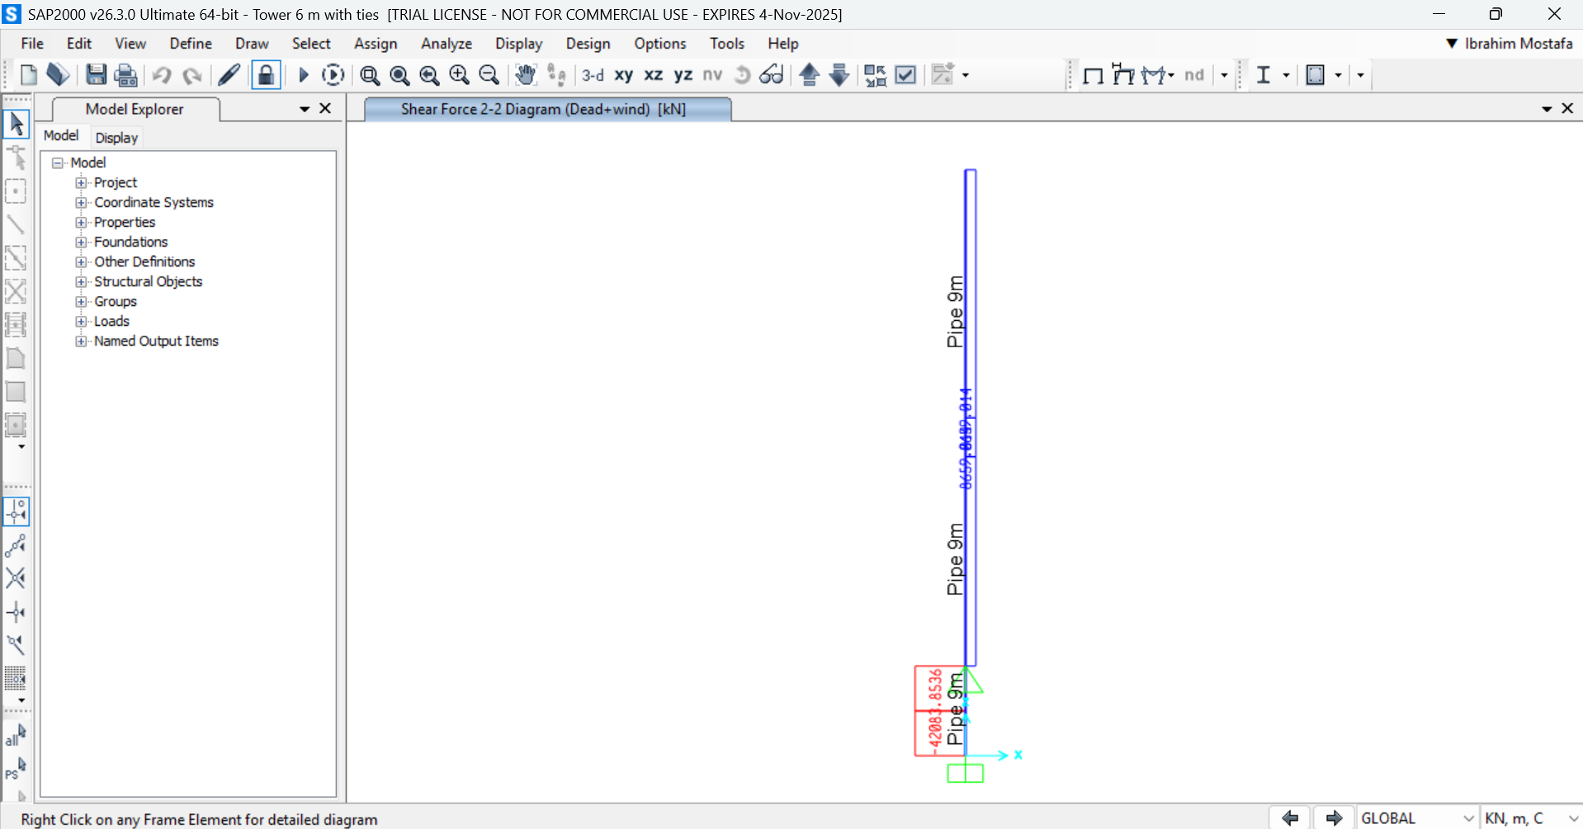
2. Tubular steel tower with tie system, primary design.
Group members: Ibrahim Mostafa, Mohammed Eldemerdash, Kirolls Ghaly
Tower structure team/ Optimus Syria

Slide 13
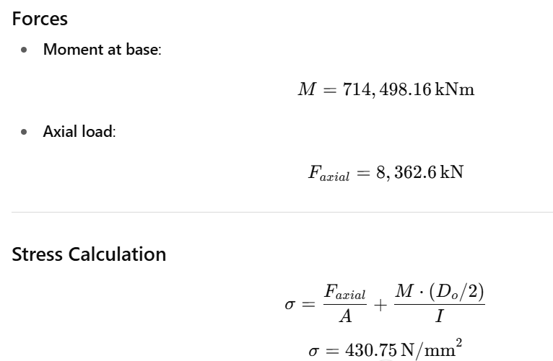
Loads calculations and stress analysis
Group members: Ibrahim Mostafa, Mohammed Eldemerdash, Kirolls Ghaly
Tower structure team/ Optimus Syria

Slide 14
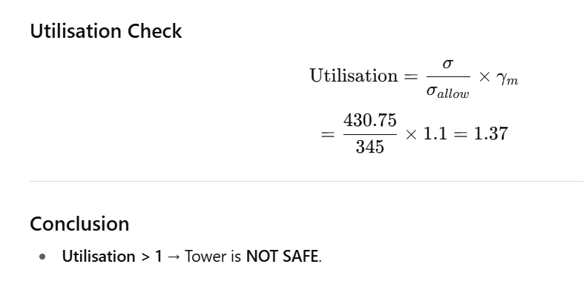
Loads calculations and stress analysis
Group members: Ibrahim Mostafa, Mohammed Eldemerdash, Kirolls Ghaly
Tower structure team/ Optimus Syria

Slide 15
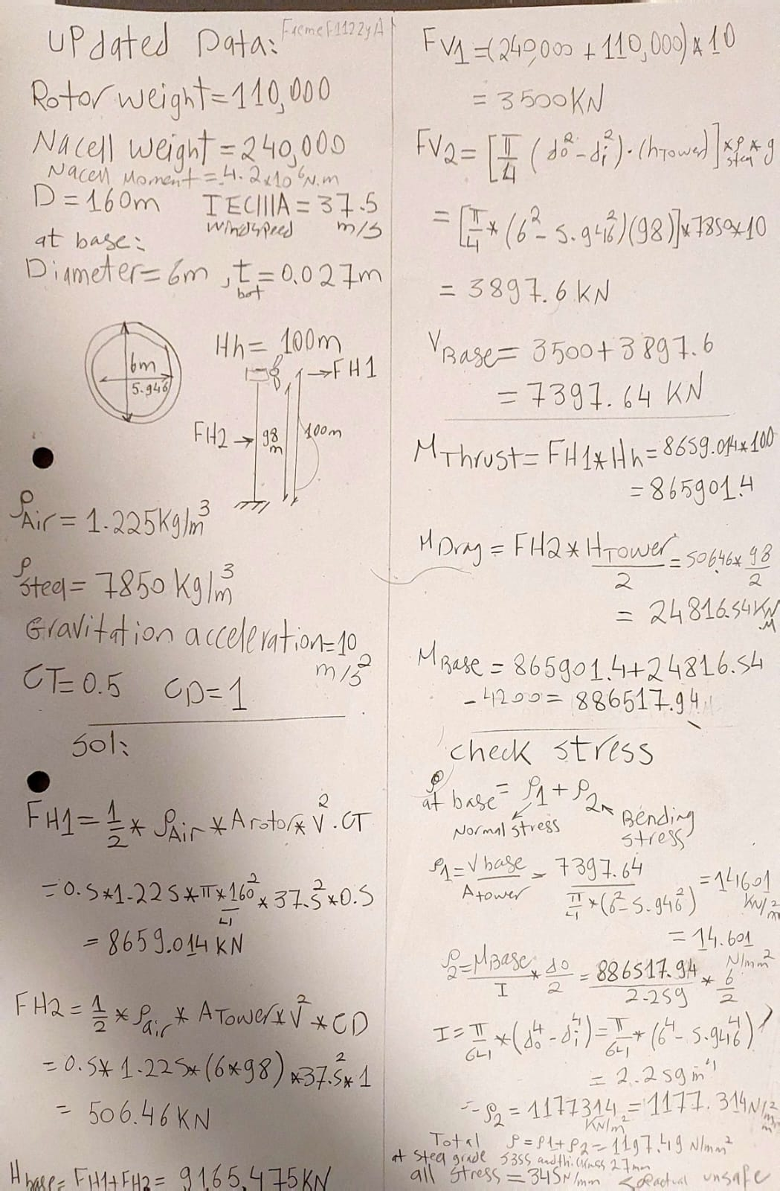
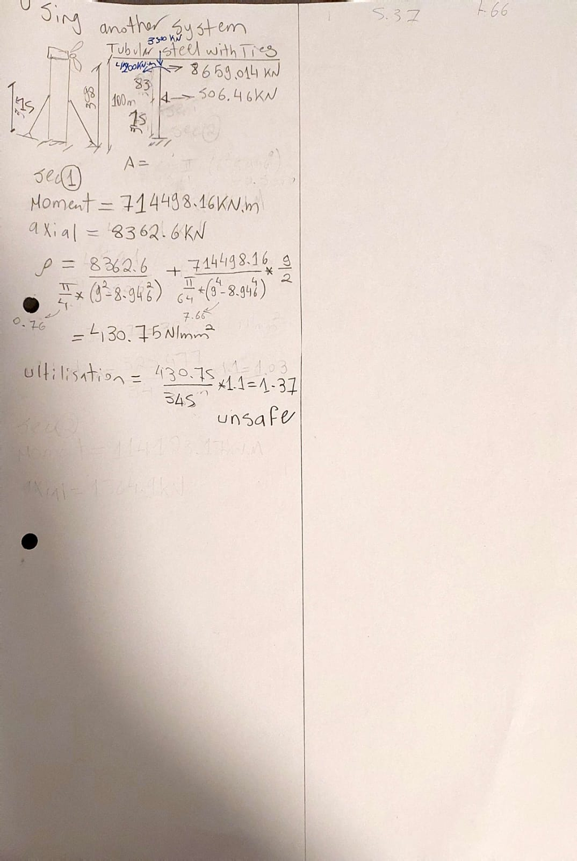
Loads calculations and stress analysis
Fig : Original handwritten calculations
Group members: Ibrahim Mostafa, Mohammed Eldemerdash, Kirolls Ghaly
Tower structure team/ Optimus Syria

Slide 16
work distribution
Mohammed Eldemerdash:
Searching for the wind loads in IEC 61400-1 code .
Ibrahim Mostafa:
Load calculations and primary design.
Kirollos Ghaly:
- no input
Group members: Ibrahim Mostafa, Mohammed Eldemerdash, Kirolls Ghaly
Tower structure team/ Optimus Syria

